Slide 1
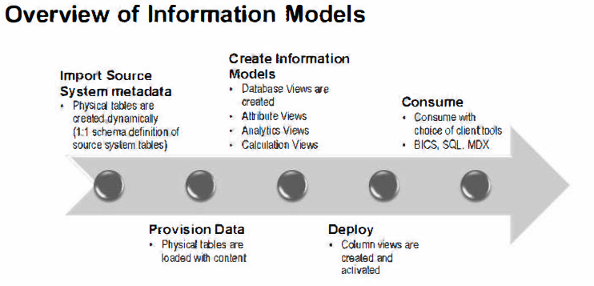

Slide 2
Creating Attribute Views
• Derived Attribute Views
• Calculated Attributes
• Time Characteristics Based Attribute Views
• Stand Alone Text Tables
• Using Base Table Aliases
• Hidden Attributes

Slide 3
Attribute views
used to select a subset of columns and rows from a data table
used to give master data tables context
This context is provided by text tables which give meaning to the master data
Normally fact table or analytic view only contains some numeric ID related to Master data
There is no need to define measures or aggregates for Attribute Views
You can also use attribute views to join master data tables to each other, e. g. joining “Plant” to “Material”
Attribute Views are reusable objects and can be shared between several Analytic Views or Calculation Views

Slide 4
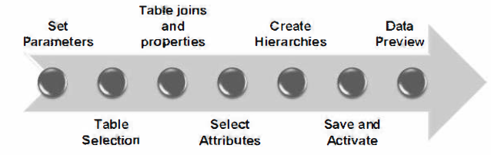
The main steps to create an Attribute View

Slide 5
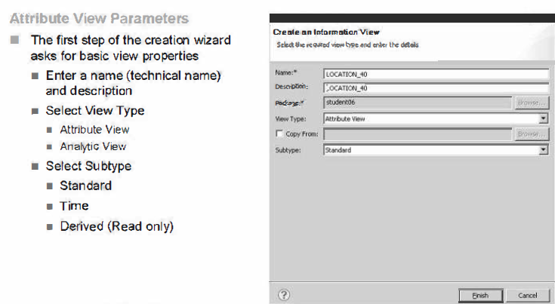
Name: The allowed characters are: capital letters (A-Z), numbers (0-9), and underscore

Slide 6
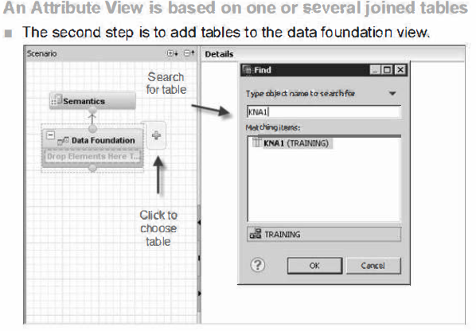
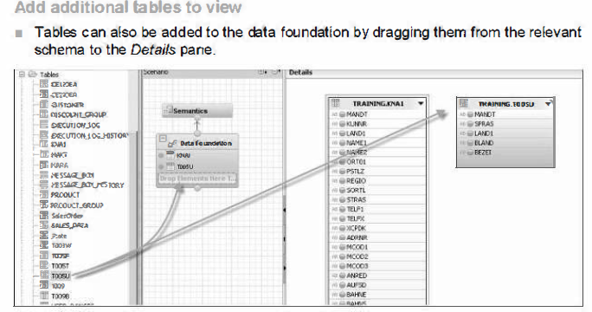

Slide 7
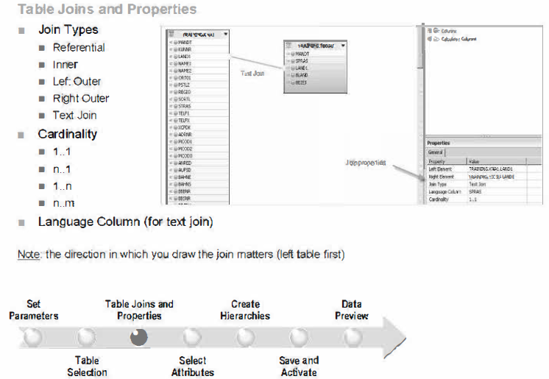

Slide 8
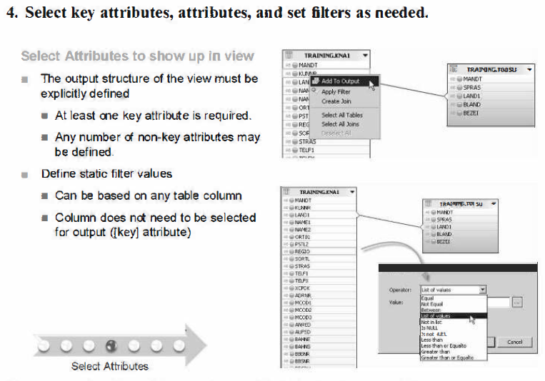

Slide 9
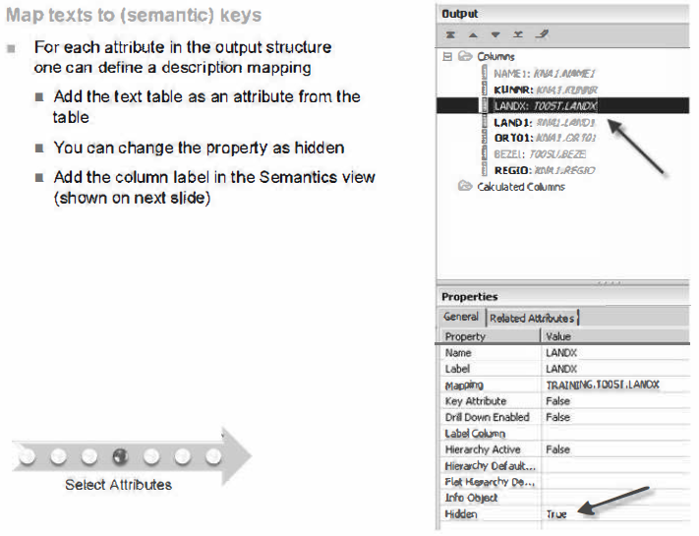

Slide 10
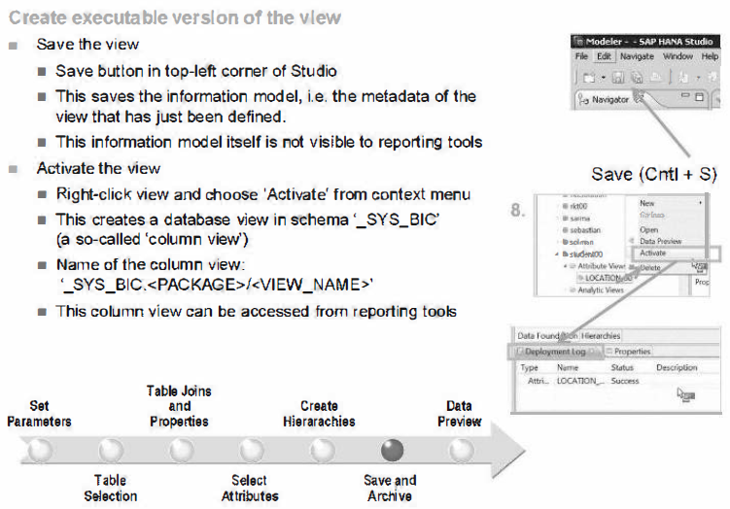

Slide 11
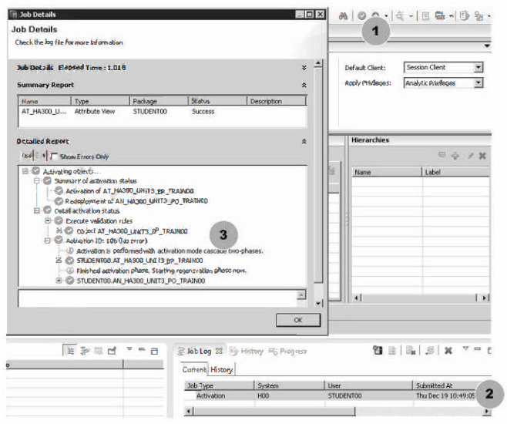

Slide 12
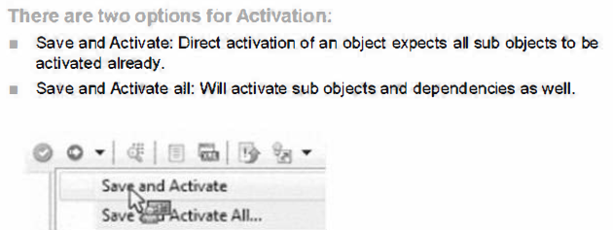
Before a view is visible for reporting, it needs to be activated (deployed). The activation process translates the metadata defined in the Information Model (the design-time object) into a database object (the run-time object, which is a so-called column view).
All the run-time column views are normally managed within the standard schema _SYS_BIC in the Catalog node of your system.
A modified version of a view cannot be activated. You always need to save the view first. There is no implicit save performed when a user tries to activate a modified view.
Once the view activation is finished, you can see the log of this activation process (button in top-right corner of the Log view. The Deployment Log is useful if there is an error during view activation.

Slide 13
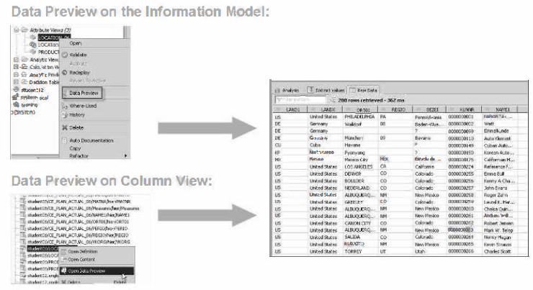
The data preview functionality is useful for confirming that one has modeled the
data the way he/she intended. It can be done at the Attribute view, or at the physical tables at the foundation level.
There are three main views one can select from when previewing data:
• Raw Data - table format of data
• Distinct Values - graphical and text format identifying unique values
• Analysis - select fields (attributes and measures) to display in graphical format
of in a table

Slide 14
Derived Attribute Views
To reuse the same Attribute View multiple times in the same Analytic or Calculation View
To achieve this, one can derive an Attribute View using the base view which acts as reference to the base Attribute View.
• The Derived Attribute View will be opened in the read only mode. The only editable field will be its description.
• The Derived Attribute View will act as a reference to its base Attribute View.

Slide 15
Calculated Columns
Calculated columns are similar to Calculated Measures by behavior
There are business needs where users would like to derive columns using available columns and calculated columns.
• The calculation could be an arithmetic or character manipulation.
• Ideally it is better to classify all calculated attributes in one place. Once created will behave like any other attributes in the whole information modeling paradigm.
• Calculated Columns also support non-measure attributes as part of the calculation.

Slide 16
Time Based Attribute Views
Information models may need to support information requirements in accordance to the calendar that are defined for reporting using fiscal calendars.
Using Attribute Views of Subtype Time enables modelers to generate different calendars and periods as defined in ERP System using ERP Fiscal Calendar tables
Two Types of Time based Attributes:
Gregorian
Fiscal

Slide 17
Generating Time Data
For modeling business scenarios that require time dimension, you generate time data in default time related tables available in the _SYS_BI schema. You can select the calendar type and granularity and generate the time data for a specific time span.
If you have selected the Gregorian calendar type,
in the Granularity dropdown list select the required granularity. (For the granularity level Week, you need to specify the first day of the week.)
If you have selected the Fiscal calendar type,
a. In Variant Schema dropdown list, select a variant schema that contains tables having variant data.(Tables T009 and T009B contain variant data.)
b. Select the required variant. The variant specifies the number of periods along with the start and end dates.
For the Gregorian calendar type, modeler generates time dimension data into M_TIME_DIMENSION_YEAR, M_TIME_DIMENSION_MONTH, M_TIME_DIMENSION_WEEK, M_TIME_DIMENSION tables and for the Fiscal calendar type, the modeler populates the generated time dimension data into the M_FISCAL_CALENDAR table. These tables are present in _SYS_BI schema.

Slide 18
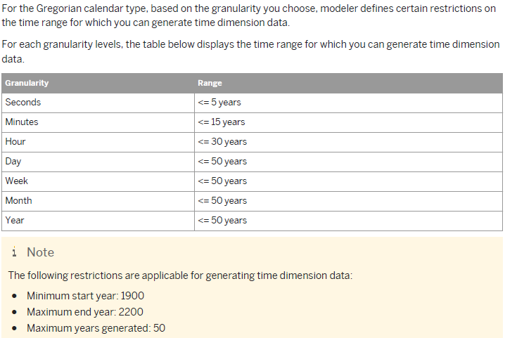

Slide 19
Stand Alone Text Tables
In some cases, there is no combination of value table and text table that can be joined with a text join and language field mapping ending up in an Attribute View.
But still we need to model those in a way that supports dynamic language handling in terms of the texts.
Those tables shall be included in an Attribute View with a dynamic filter on the language field ($$language$$).

Slide 20
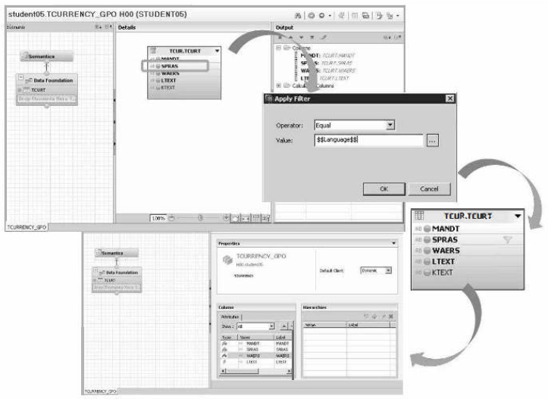

Slide 21
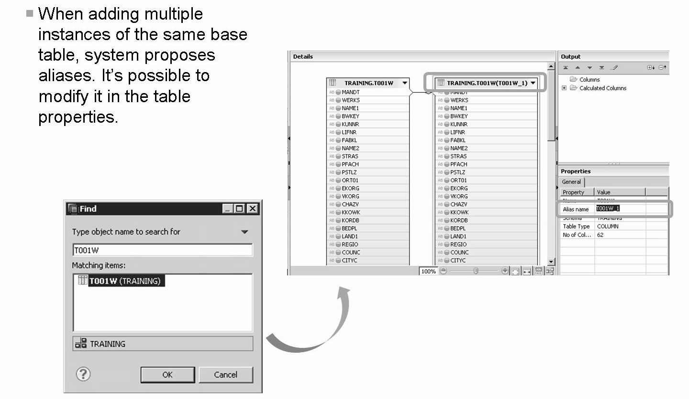
Adding Multiple Base Tables Using Aliases
By adding the table again, just as when adding it the first time, a prompt box will ask you to provide an alias for the new instance of the base table.

Slide 22
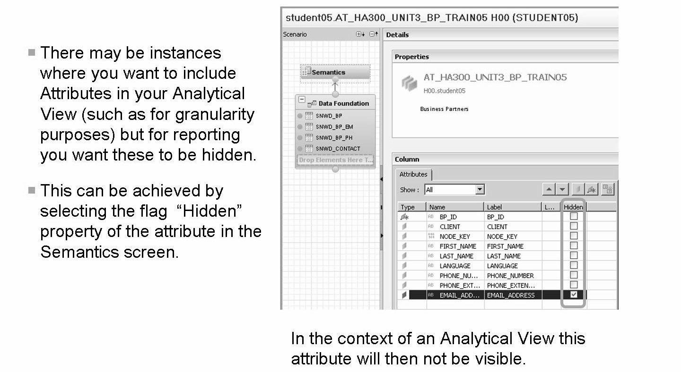
Hidden Attributes

Slide 23
THANK YOU
Courtesy : SAP Labs Document -
HA 300 – SAP HANA Implementation and Modeling

